Slide 1
U-Net based Tooth Segmentation and Caries Detection in Digital Dental Radiography
Sreyas Rejil
20BCE1930
Dr.Pattabiraman V

Slide 2
Introduction
Dental caries, a common problem among people, occurs when bacteria in the mouth break down food, producing acids that erode tooth minerals.
In the beginning, caries appears as white spots on the teeth, which can be seen without any special equipment. It's crucial to spot these early signs because they indicate the start of tooth decay. As caries progress deeper into the enamel, dental X-rays become essential for detection.
Dentists usually use visual inspection to identify visible caries, but often, the initial stages of decay are not visually apparent. Radiographic images help detect caries and other details which are not easily visible to the naked eye.
The manual annotation of these structures proves labor-intensive and susceptible to inter-observer variability, showcasing the importance for automated segmentation methods.

Slide 3
Introduction
Our aim is to create a model which is able to efficiently segment tooth and detect caries if present to aid the clinicians in performing their diagnosis.
This assistance contributed to more accurate early diagnosis and detection, particularly in cases belonging to the initial and moderate caries groups.
This can not only speed up the overall process, by removing the need for manual segmentation which is usually done using professional segmentation software, but also reduces the manpower needed in the entire process.
Our model can easily be exported and run to produce the segmented output in under a second in most modern GPU’s.

Slide 4
Problem Statement
Manual segmentation of dental structures and pathologies in radiographic images is a time-consuming and labor-intensive task.
Dental professionals spend significant resources annotating these images, which not only increases the overall cost but also introduces subjectivity and variability in the segmentation process.
Many studies rely on models trained on large private datasets, which can be hard to access.
Our approach suggests using publicly available datasets along with different augmentation techniques, modified U-Net architectures, and transfer learning to achieve comparable segmentation outcomes.

Slide 5
Research Objectives
Efficiently segment teeth in digital dental radiographs to reveal underlying structures for diagnostic purposes.
Develop a robust algorithm for detecting caries with high accuracy and reliability in dental radiography.
Implement transfer learning techniques and modify the U-Net architecture to effectively train models on smaller datasets, optimizing performance.
Demonstrate the feasibility and effectiveness of U-Net-based approaches for tooth segmentation and caries detection in digital dental radiography, contributing to enhanced clinical workflows and patient care.

Slide 6
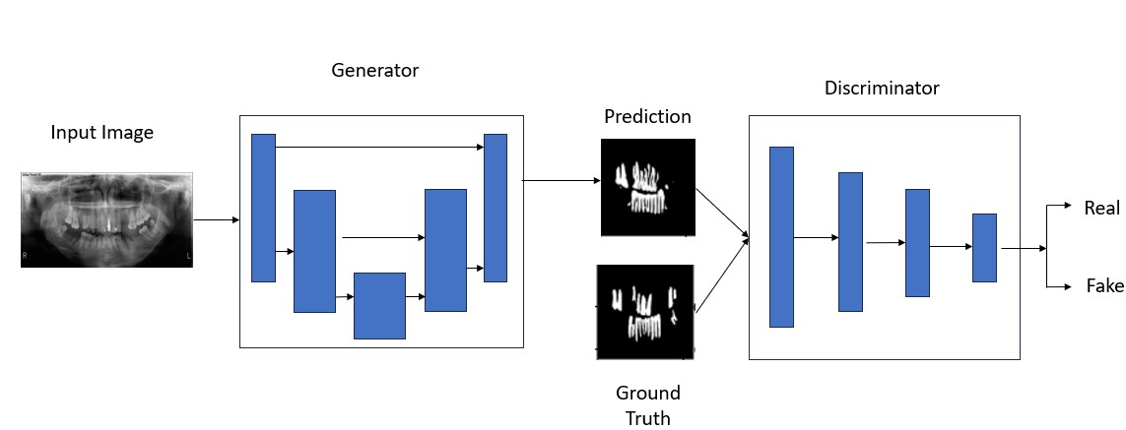
Proposed System – Tooth Segmentation

Slide 7
Proposed System – Tooth Segmentation
The U-Net architecture comprises two main segments: the contracting path, also known as the encoder, and the expanding path, or decoder.
The Encoder module takes the input image and executes convolution operations to reduce its dimensionality. This process aids in noise reduction, elimination of irrelevant features, and enhances the learning process of the generator.
On the other hand, the Decoder module is responsible for performing up-sampling operations using 2D Convolution transpose. It also incorporates skip connections to amalgamate features from earlier stages of the network, thereby preserving vital spatial details and fine-grained features.
As for the Generator component, it leverages the U-Net architecture, encompassing both the Encoder and Decoder segments. This module accepts random noise or input data and generates synthetic output data, typically images, conditioned on the input.
We train the generator to learnt the intrinsic details of the tooth ,its shape and minor details to perform accurate segmentation.

Slide 8
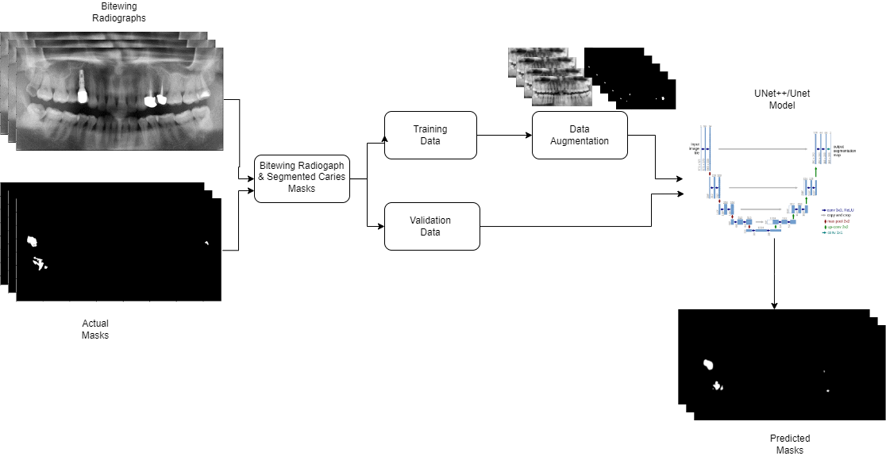
Proposed System – Caries Segmentation

Slide 9
Proposed System – Caries Segmentation
In the development of the caries detection model, we explored three distinct approaches:
UNet architecture coupled with an EfficientNetB0 model as the encoder
U-Net++ architecture with an EfficientNetB0 backbone
U-Net model with a ResNet34 encoder backbone
U-Net++ builds upon the traditional U-Net architecture, introducing enhancements to improve segmentation effectiveness. Notably, U-Net++ incorporates full-scale skip connections, which establish connections between layers at the same resolution.
These connections effectively merge low-level and high-level features, enriching the network's representation.

Slide 10
List Of Modules
Image Pre-Processing – Tooth Segmentation & Caries Segmentation
Model Training & Model Building
Image Segmentation
Metrics Evaluation and Validation

Slide 11
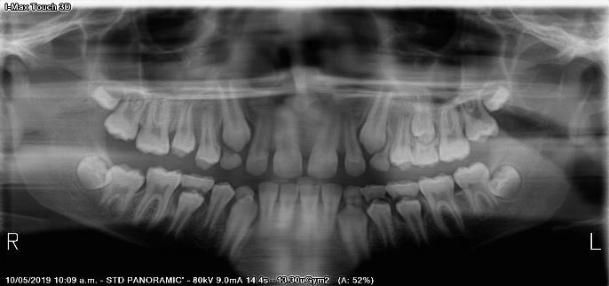
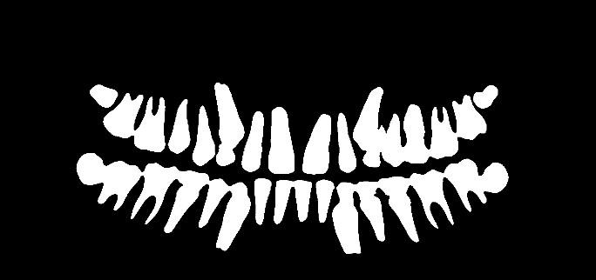
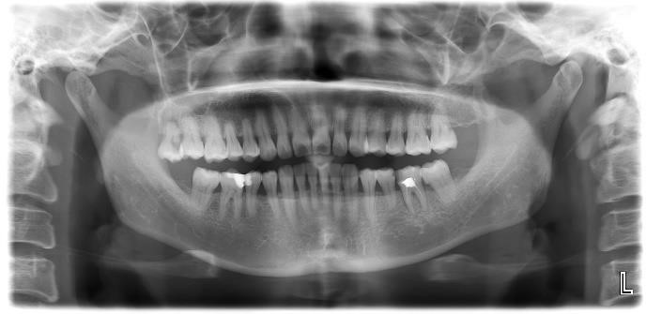
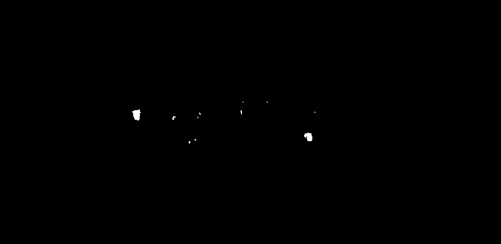
Image Pre-Processing
Given the intricacies of dental images and the need for precise segmentation, preprocessing techniques such as normalization and resizing are applied to standardize the images and ensure consistency across the dataset.
Additionally, augmentation methods such as rotation, flipping, and brightness adjustments are employed to augment the dataset.
Radiograph Image with segmented Mask

Slide 12
Model Training
For the tooth segmentation model, we adopted a U-Net architecture trained exclusively on our dataset of dental radiograph images paired with segmented masks.
For the caries segmentation model , due to a smaller dataset size we explored using pre-trained models as our backbone to perform transfer learning.
We resize the images to a smaller 224*224 size to allow mini-batch training. Which is more computationally efficient especially when dealing with hardware constraints.
Since the caries model is dealing with a much smaller dataset , we reduced the batch size to achieve more stability while training.
PARAMETER | VALUE – Caries Segmentation | VALUE – Tooth Segmentation
EPOCHS | 100 | 8000
BATCH SIZE | 8 | 16
OPTIMIZER | ADAM | RMSPROP
LOSS FUNCTION | DICE LOSS | MSE
METRICS | IOU, ACCURACY, PRECISION, DICE | ACCURACY , PRECISION , RECALL

Slide 13
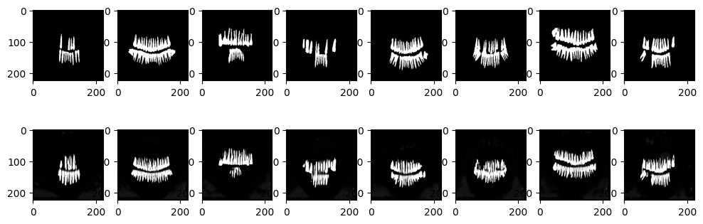
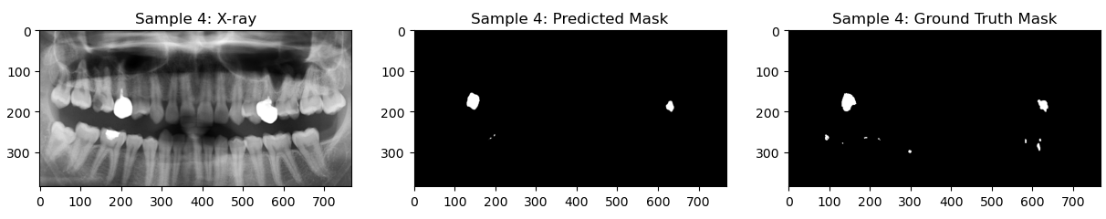
Image Segmentation
Tooth Segmentation - Train the GAN over specified epochs , till the generator is able to segment the images appropriately , monitor the Generator Loss and Discriminator Loss to prevent challenges such as Mode Collapse , Convergence etc.
Caries Segmentation – Train the augmented dataset on the various chosen architectures and encoder weights. The weights for all will be based on ImageNet v8.
Tooth Segmentation – Model Training
Caries Segmentation – Model Working

Slide 14
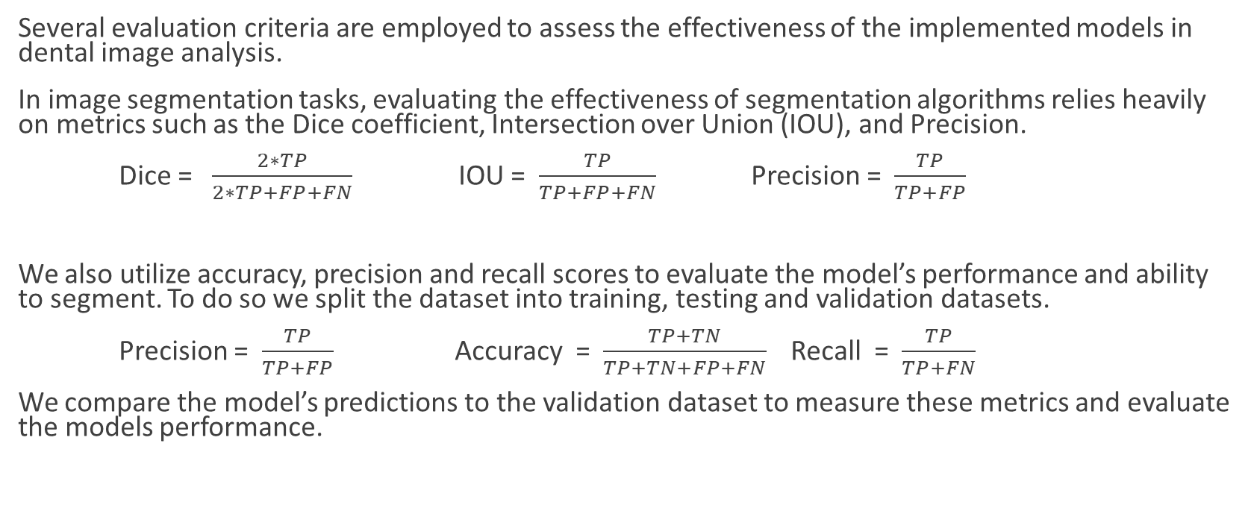
Metrics Evaluation and Validation
Several evaluation criteria are employed to assess the effectiveness of the implemented models in dental image analysis.
In image segmentation tasks, evaluating the effectiveness of segmentation algorithms relies heavily on metrics such as the Dice coefficient, Intersection over Union (IOU), and Precision.
Dice = $\frac{2∗TP}{2∗TP+FP+FN}$ IOU = $\frac{TP}{TP+FP+FN}$ Precision = $\frac{TP}{TP+FP}$
We also utilize accuracy, precision and recall scores to evaluate the model’s performance and ability to segment. To do so we split the dataset into training, testing and validation datasets.
Precision = $\frac{TP}{TP+FP}$ Accuracy = $\frac{TP+TN}{TP+TN+FP+FN}$ Recall = $\frac{TP}{TP+FN}$
We compare the model’s predictions to the validation dataset to measure these metrics and evaluate the models performance.

Slide 15
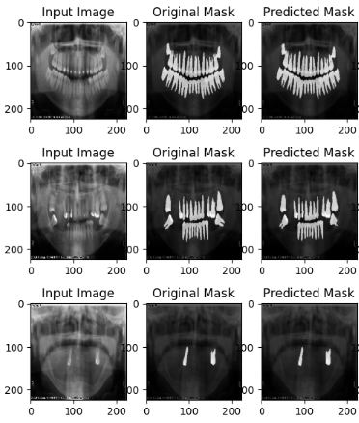
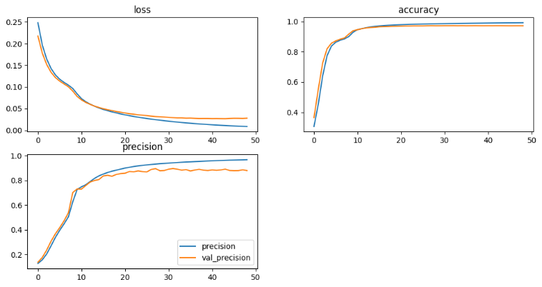
Implementation – Tooth Segmentation
The model demonstrated substantial performance metrics during validation, with an accuracy of 0.9722, precision of 0.8794, and recall of 0.8736.
The availability of a more extensive dataset enabled the U-Net-based GAN to generalize better, effectively learning the nuances and complexities inherent in dental images.

Slide 16
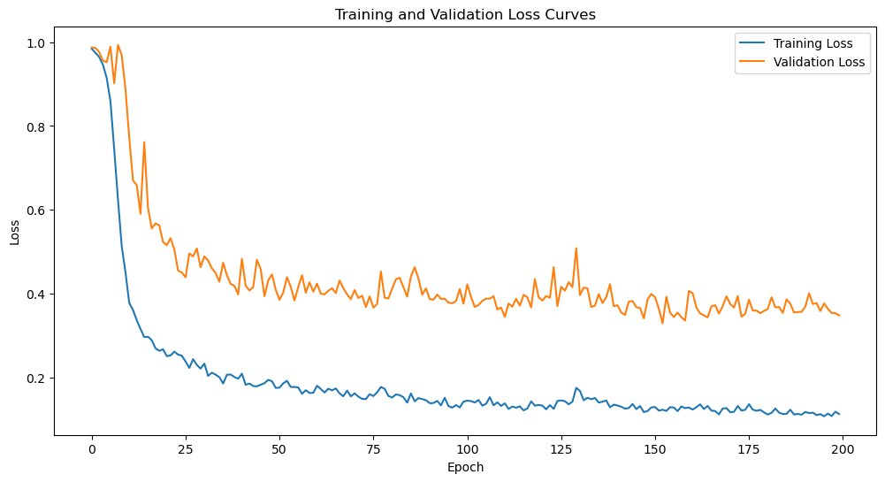
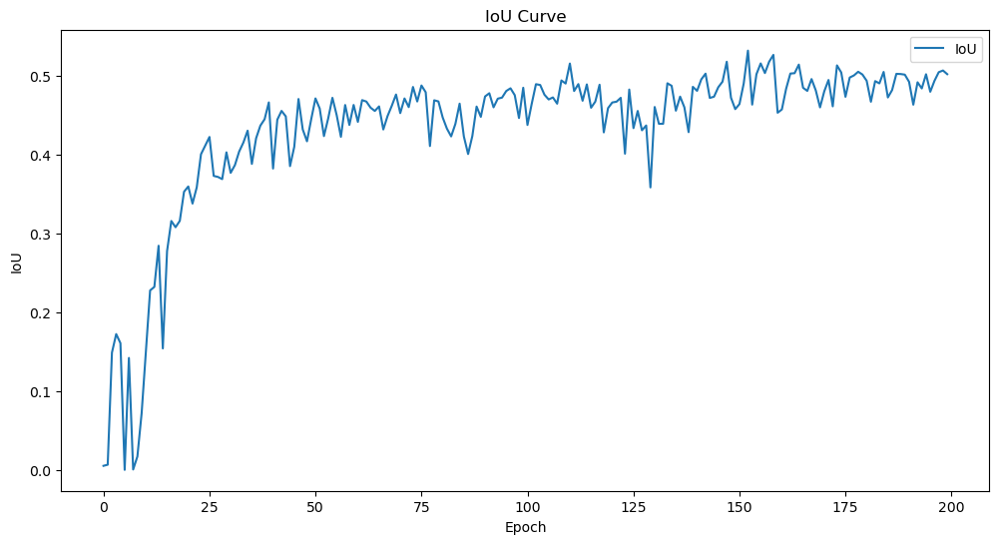
Implementation – Caries Segmentation
In our approach to the segmentation task, we incorporated three distinct pre-trained models as the encoders within the U-Net architecture, serving as the foundational framework for our models. Each model underwent training for fewer than 200 epochs, carefully monitoring the onset of overfitting to ensure optimal performance.
All three models exhibited comparable training-validation curves and IOU curves. Notably, these curves plateaued around 75 epochs, indicating a stabilization of performance. Subsequent epochs showed minimal improvement, with the models eventually exhibiting signs of overfitting.

Slide 17
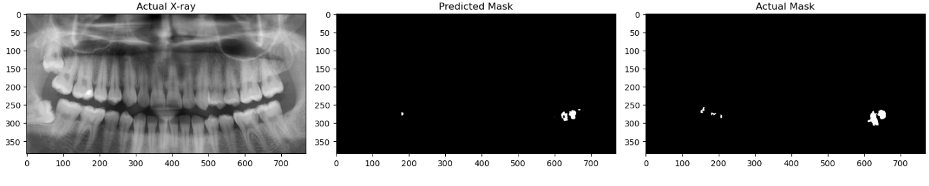
Table 2 :Caries Segmentation Metrics
Among the 3 model’s we trained the U-Net EfficientNet-b0 model emerges as the most promising candidate, surpassing its counterparts in IOU, Precision, and Dice coefficient.
While ResNet34 is known for its deeper architecture, its performance may be impacted by the specific characteristics of the caries detection task, suggesting that the dataset is not large enough to benefit from the increased network depth.
ARCHITECTURE | MODEL | IOU | PRECISION | DICE
U-NET | EFFECIENTNET-B0 | 0.5422 | 0.7613 | 0.6865
U-NET | RESNET34 | 0.4516 | 0.6911 | 0.5917
U-NET++ | EFFECIENTNET-B0 | 0.4658 | 0.7489 | 0.6030

Slide 18
Findings and Discussion
The tooth segmentation model was able to efficiently segment and display the various intricate features from the radiograph, and was shown effective in even rare cases where the alignment and structure of tooth are different. The model was able to perform this segmentation in under 2 seconds in our testing environment on Google Colaboratory with a TPU.
In the caries segmentation model , the U-Net EfficientNet-b0 model emerges as the most promising candidate, surpassing its counterparts in IOU, Precision, and Dice coefficient.
Despite the challenges posed by the small dataset the caries detection model showed great promise, with an IOU score of 0.542 and a precision of 0.761. In most image segmentation tasks, an IOU score of 0.5 and above is generally accepted as good.

Slide 19
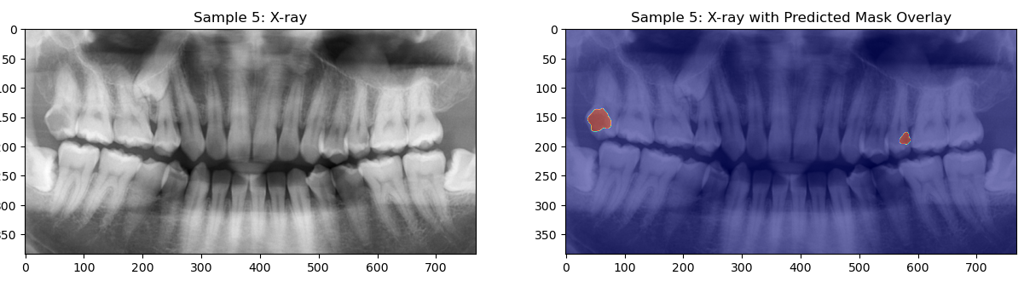
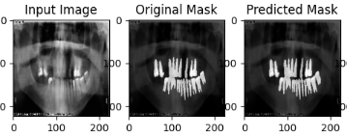
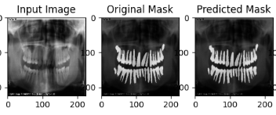
Caries Segmentation Model
Tooth Segmentation Model

Slide 20
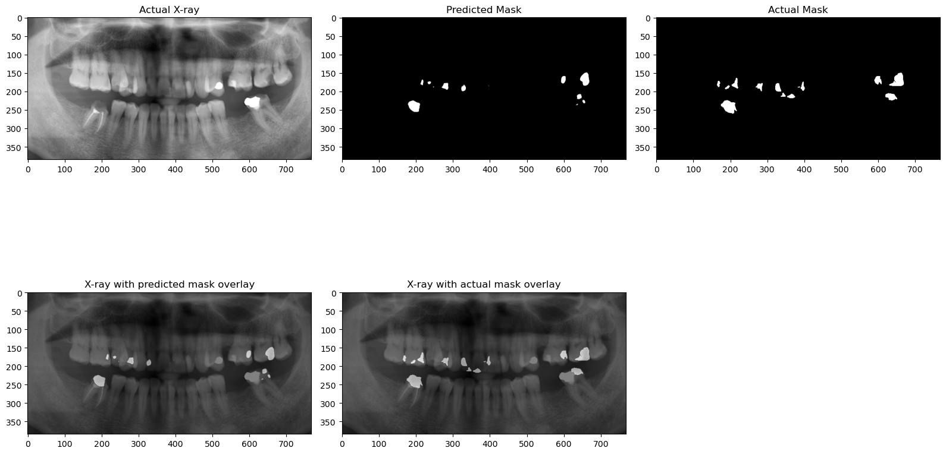
Caries Segmentation model working

Slide 21
Conclusion
Current research often relies on large proprietary datasets and custom-built models tailored for segmentation tasks which are difficult to train and maintain.
However, our study demonstrates an alternative approach by leveraging transfer learning techniques, coupled with image augmentation methods and modified architectures incorporating skip-layer excitation’s.
This method has proven to be efficient in developing models capable of achieving accurate segmentation results when data available is scarce.
Our model's ability to segment teeth opens up various clinical uses, like planning treatments, assessing orthodontic needs, and making the diagnosis more efficient.

Slide 22
Future Work
Further efforts will be directed towards addressing the limitations associated with the small dataset and refining our caries segmentation model. A larger more diverse dataset can help increase models ability to segment on rarer cases.
One potential approach is the utilization of Generative Adversarial Networks (GANs) to synthesize additional dental images, thereby expanding the dataset size and enhancing the robustness of our U-Net models.
While our models were evaluated using standard metrics, such as accuracy and Intersection over Union (IOU), involving medical professionals to assess segmented images can provide valuable insights and ensure the clinical relevance of our models.
Training the model on higher resolution images could also lead to better results , when hardware resources are not a limiting factor.

Slide 23

Guide Approval

Slide 24
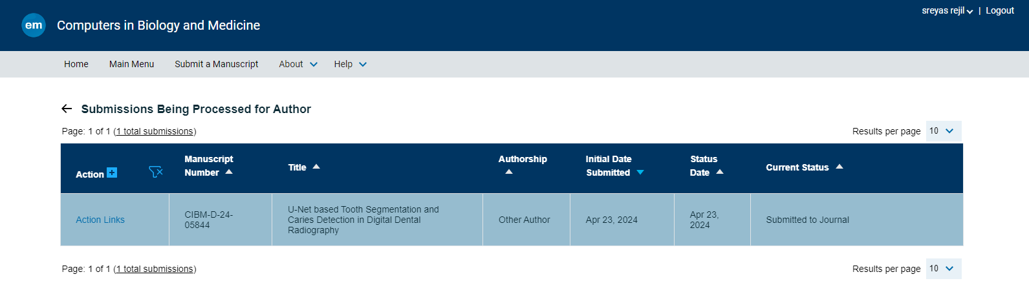
Research Paper Status
Submitted to journal

Slide 25


U-Net based Tooth Segmentation and Caries
Detection in Digital Dental Radiography
Sreyas Rejil– 20BCE1930
Dr.Pattabiraman V
School of Computer Science and Engineering
INTRODUCTION
Dental caries, a common problem among people, occurs when bacteria in the mouth break down food, producing acids that erode tooth minerals.
In the beginning, caries appears as white spots on the teeth, which can be seen without any special equipment. It's crucial to spot these early signs because they indicate the start of tooth decay. As caries progress deeper into the enamel, dental X-rays become essential for detection.
Dentists usually use visual inspection to identify visible caries, but often, the initial stages of decay are not visually apparent. Radiographic images help detect caries and other details which are not easily visible to the naked eye.
The manual annotation of these structures proves labor-intensive and susceptible to inter-observer variability, showcasing the importance for automated segmentation methods.
OBJECTIVES
Efficiently segment teeth in digital dental radiographs to reveal underlying structures for diagnostic purposes.
Develop a robust algorithm for detecting caries with high accuracy and reliability in dental radiography.
Implement transfer learning techniques and modify the U-Net architecture to effectively train models on smaller datasets, optimizing performance.
Demonstrate the feasibility and effectiveness of U-Net-based approaches for tooth segmentation and caries detection in digital dental radiography, contributing to enhanced clinical workflows and patient care.
SCOPE OF THE PROJECT
The scope of this project is to utilize U-Net based architectures for tooth and caries segmentation, aiding clinicians for quicker ,efficient and more accurate diagnosis.
METHODOLOGY
Given the intricacies of dental images and the need for precise segmentation, preprocessing techniques such as normalization and resizing are applied to standardize the images and ensure consistency across the dataset.
Additionally, augmentation methods such as rotation, flipping, and brightness adjustments are employed to augment the dataset.
ARCHITECTURE
The U-Net architecture comprises two main segments: the contracting path, also known as the encoder, and the expanding path, or decoder.
The encoder, located on the left side of the architecture, employs convolutional and pooling layers to reduce spatial dimensions while capturing important high-level features.
The decoder, situated on the right side, utilizes transposed convolutions and up-sampling layers to restore spatial dimensions while integrating contextual information from the encoder.
This integration ensures thorough feature extraction and semantic understanding during segmentation.
We employ different hyperparameters and architectures for our proposed models, each will then be designed accordingly based on the dataset and hardware resources available.
Finally, the model’s performance will be evaluated with various evaluation metrics.
.
RESULTS
The tooth segmentation model too demonstrated substantial performance metrics during validation, with an accuracy of 0.9722, precision of 0.8794, and recall of 0.8736.
CONCLUSION
The tooth segmentation and caries detection model show great promise in improving dental diagnosis and treatment. Utilizing transfer learning ,Image augmentation methods and modified architectures using skip-layer excitations we are able to accurately segment without the need for large proprietary datasets which are difficult to acquire in medical fields.
CONTACT DETAILS
MAIL ID : Sreyas.rejil2020@vitstudent.ac.in
MOBILE NO : 9153838389
REFERENCES
Zhang Y, Ye F, Chen L, Xu F, Chen X, Wu H, Cao M, Li Y, Wang Y, Huang X. Children's dental panoramic radiographs dataset for caries segmentation and dental disease detection. Sci Data. 2023 Jun 14;10(1):380.
Lian L, Zhu T, Zhu F, Zhu H. Deep Learning for Caries Detection and Classification. Diagnostics (Basel). 2021 Sep 13;11(9):1672.
Architecture | Model | IOU | Precision | Dice
U-NET | EFFECIENTNET-B0 | 0.542 | 0.7613 | 0.686
U-NET | RESNET34 | 0.451 | 0.6911 | 0.591
U-NET++ | EFFECIENTNET-B0 | 0.465 | 0.7489 | 0.603

Slide 26
References
[1] Zhang Y, Ye F, Chen L, Xu F, Chen X, Wu H, Cao M, Li Y, Wang Y, Huang X. Children's dental panoramic radiographs dataset for caries segmentation and dental disease detection. Sci Data. 2023 Jun 14;10(1):380.
[2] ] Lian L, Zhu T, Zhu F, Zhu H. Deep Learning for Caries Detection and Classification. Diagnostics (Basel). 2021 Sep 13;11(9):1672
[3] Kim, H.E., Cosa-Linan, A., Santhanam, N. et al. Transfer learning for medical image classification: a literature review. BMC Med Imaging 22, 69 (2022).
[4] Lee, S., Oh, Si., Jo, J. et al. Deep learning for early dental caries detection in bitewing radiographs. Sci Rep 11, 16807 (2021).
[5] Xianyun Wang, Sizhe Gao, Kaisheng Jiang, Huicong Zhang, Linhong Wang, Feng Chen, Jun Yu, and Fan Yang. 2023. Multi-level uncertainty aware learning for semi-supervised dental panoramic caries segmentation. Neurocomput. 540, C (Jul 2023).

